Slide 1
Statistical mediation analysis – overview, recent developments and an application in cancer epidemiology
2021/09/16 – LUPOP seminar, Methodological issues in epidemiology and population research
Josef Fritz
josef.fritz@i-med.ac.at
Department of Medical Statistics, Informatics, and Health Economics
Medical University of Innsbruck
Austria

Slide 2
Part 1: Mediation analysis from a causal inference perspective -
Concepts, theory, and estimation methods

Slide 3
Motivation
Cause-and-effect relationship
How does this effect come about?
What are the underlying mechanisms?
Statistical mediation analysis
Quantifying specific causal pathways measured via specific variables which are assumed to be affected by the exposure and themselves affect the outcome
Total effect
Indirect (mediated) effect (red arrows)
Direct effect (green arrow)
M
→Mediation analysis
X
Y

Slide 4
Directed acyclic graphs (DAGs)
Making causal assumptions explicit
Arrow - indicates a causal effect of one node (variable) on another
Are based on knowledge in the respective research field
Useful for e.g.:
Illustrate the underlying causal framework
Selection of confounders
Graphical presentation of biases
Mediation analysis
M
X
Y

Slide 5
Directed acyclic graphs (DAGs)
C
Path - a consecutive sequence of arrows
Causal vs. non-causal
Open vs. blocked
“Statistical association” can flow through an open path, but not a blocked on
M
X
Y
Z
C – Confounder
M – Mediator
Z - Collider

Slide 6
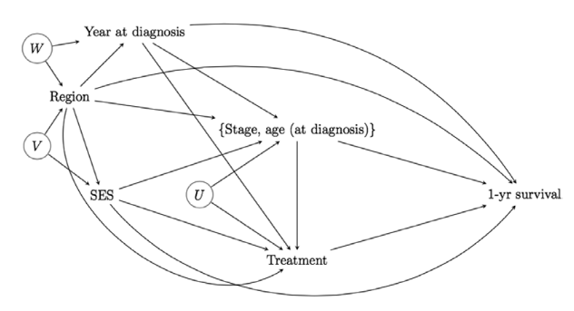
Causal diagrams can be complex

Slide 7
Traditional difference method
C
Calculate a model without the mediator → total effect
Calculate another model conditioned on the mediator → direct effect
3. If the coefficients $β_{X}$ and ${\text{α}}_{X}$ differ, then some of the effect is thought to be mediated
3’. The indirect effect is the difference between total and direct effect
M
X
Y
T. VanderWeele. Mediation Analysis: A Practitioner's Guide. Annual review of public health, 2012.

Slide 8
Challenges
→Need for generic, formal definitions of the desired effects (estimands).
Confounding
Multiple mediators (parallel, sequential)
Interactions between exposure and mediator(s)
Non-linear dependencies
The conditional OR (“direct effect”) is 3.86 in both groups, but the marginal OR (“total effect”) is 2.25
Difference method leads to wrong conclusion of an indirect effect being present!
Non-collapsibility of the OR
 | Z=1 (N=200) |  | Z=0 (N=200) |  | Marginal (N=400)
 | X=1 | X=0 | X=1 | X=0 | X=1 | X=0
Y=1 | 90 | 70 | 30 | 10 | 120 | 80
Y=0 | 10 | 30 | 70 | 90 | 80 | 120
OR | 3.86 |  | 3.86 |  | 2.25
Z
X
Y

Slide 9
Counterfactual framework
Y
X
The potential outcome of a variable Y (outcome) is simply the value Y would have taken for individual u, had X (exposure) been assigned the value of x.
In reality we are unable to see the outcome Y for an individual u given X or x, therefore we must rely on statistical modelling and assumptions for our estimates to be valid.
J. Pearl, The Book of Why, 2018

Slide 10
Potential outcomes and counterfactuals
 | Flu shot (X) | Got the flu (Y) | Y(X=0) | Y(X=1) | Causal effect?
Jonas | 0 | 1 | 1 | 1 | No
Dave | 1 | 0 | 1 | 0 | Yes (protective)
Mike | 1 | 0 | 0 | 0 | No
Sarah | 1 | 1 | 0 | 1 | Yes (harmful)
Susan | 0 | 0 | 0 | 0 | No
Tom | 0 | 1 | 1 | 0 | Yes (protective)
Counterfactual outcomes (not observed)
Was the flu shot the cause why Dave did not get the flu?
We do not know.
To answer this, we need to know what would have happened had he not gotten the flu shot.
Y(X=0) and Y(X=1) represent the potential outcomes under both conditions.
The outcome we do not observe is called the counterfactual.

Slide 11
Total, natural direct and natural indirect effect
Total effect (TE) of X on Y (level a vs. a*):
Y(X=a) - Y(X=a*) for each individual
E[Y(X=a)] – E[Y(X=a*)]
E[Y(X=a,M=M(a))] – E[Y(X=a*,M=M(a*))]
Natural indirect effect (NIE):
E[Y(X=a,M=M(a))] – E[Y(X=a,M=M(a*))] (nested counterfactual!)
Natural direct effect (NDE):
E[Y(X=a,M=M(a*))] – E[Y(X=a*,M=M(a*))]
Controlled direct effect (CDE):
E[Y(X=a,M=m)] – E[Y(X=a*,M=m)]
M
X
Y
→TE = NIE + NDE
Pearl J. Direct and Indirect Effects. In: Proceedings of the Seventeenth Conference on Uncertainty and Artificial Intelligence. 2001.

Slide 12
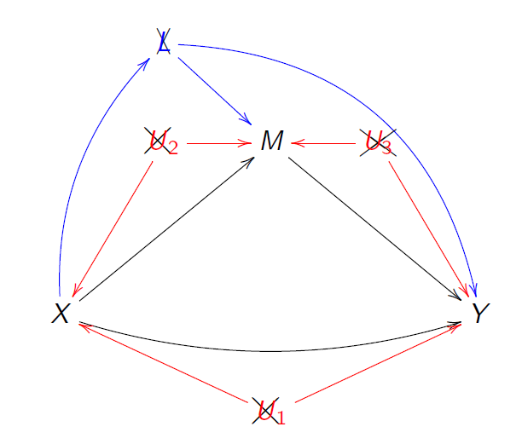
Mediation formula (Pearl, 2012)
IF there is no uncontrolled confounding of the
Exposure-outcome relationship
The exposure-mediator relationship
The mediator-outcome relationship
AND IF the ‘cross-world’ independence assumption holds, i.e. no exposure-induced mediator-outcome confounder
AND IF the positivity and consistency assumptions hold
THEN we have:
$${\text{E}\text{[}\text{Y}\text{(}\text{X}\text{=}\text{a}\text{,}\text{M}\text{=}\text{M}\text{(}a^{∗}\text{))]}}^{}\text{=}\sum_{cεC, mεM}{E\left[Y | X=a,M=m,C=c\right]∗P\left(M=m | X=a^{∗},C=c\right)∗P\left(C=c\right) }$$
non-parametric, curse of dimensionalty → parametric models needed

Slide 13
Derivation of the mediation formula
Applied mediation analyses: a review and tutorial
Epidemiology and Health, 2017
i – cross-world independence assumption:
ii – no uncontrolled confounding :
iii – consistency:
,
,

Slide 14
Mediation formula applied
 | Z=1 (N=200) |  | Z=0 (N=200) |  | Marginal (N=400)
 | X=1 | X=0 | X=1 | X=0 | X=1 | X=0
Y=1 | 90 | 70 | 30 | 10 | 120 | 80
Y=0 | 10 | 30 | 70 | 90 | 80 | 120
OR | 3.86 |  | 3.86 |  | 2.25
Z
X
Y
E[Y(1,Z(1))] = 0.6 → Odds for Y(1,Z(1)) = 1.5
E[Y(1,Z(0))] = 0.6 → Odds for Y(1,Z(0)) = 1.5
E[Y(0,Z(0))] = 0.4 → Odds for Y(0,Z(0)) = 0.67
TE = Odds for Y(1,Z(1)) / Odds for Y(0,Z(0)) = 2.25
NIE = Odds for Y(1,Z(1)) / Odds for Y(1,Z(0)) = 1.0
NDE = Odds for Y(1,Z(0)) / Odds for Y(0,Z(0)) = 2.25
TE = NIE * NDE

Slide 15
Regression-based approaches Tyler VanderWeele
Time-to-event outcome Y modeled via the following proportional hazards model (“Outcome model”):
$\left.λ_{Y}\left(t | X=x,M=m,C=c\right)=λ_{Y}\left(t | X=0,M=0,C=0\right)×exp{(}αx+βm+γxm+κc\right)$
Continuous mediator via the following linear regression model (“Mediator model”)
$E\left(M | X=x,C=c\right)=ζ+ηx+θc$ (with error term ${ δ}^{2}$)
Then, if the assumptions for the identification of NIEs and NDEs hold, and if the outcome is rare:
${{NDE}_{HR}\left(Y\right)}_{x,x^{∗}}=exp(α+γ×(ζ$ $+ ηx^{∗}+$ $θ$c $+βδ^{2}$) $×\left(x−x^{∗}\right)+0.5γ^{2}δ^{2}×\left(x^{2}−{x^{∗}}^{2}\right)$
${NIE}_{HR}{\left(Y\right)}_{x,x^{∗}}=exp(ηβ+ηγx)$ $×(x−x^{∗})$
R package regmedint (version 0.2.1)
VanderWeele TJ. Causal mediation analysis with survival data. Epidemiology, 2012.
VanderWeele TJ. Explanation in Causal Inference: Methods for Mediation and Interaction. 1st ed. Oxford University Press, 2015.

Slide 16
Natural effect models (NEMs) Theis Lange (2012)
NEM – a regression model for the nested counterfactual
$g\left(E\left[Y(a,M(a^{∗})\right]\right)=α_{0}+α_{1}∗a+α_{2}∗a^{∗}$
g – link function
α₁ – (marginal) natural direct effect
α₂– (marginal) natural indirect effect
T. Lange et al. A simple unified approach for estimating natural direct and indirect effects. Am J Epidemiol 2012.
T. Lange et al. Assessing natural direct and indirect effects through multiple pathways. Am J Epidemiol 2014.

Slide 17
Estimation algorithm for NEM (imputation-based approach)
Using the original data, fit a regression model to the outcome conditioned on confounders, exposure, and mediator (MODEL 1).
Original dataset |  |  |  |  | Extended dataset
ID | X | M | Y | C | ID | X | X* | M | Y | C
0001 | 0 | 1 | 0 | 0 | 0001 | 0 | 0 | 1 | 0 | 0
 |  |  |  |  | 0001 | 0 | 1 | 1 | 0.85 | 0
0002 | 1 | 1 | 1 | 0 | 0002 | 1 | 1 | 1 | 1 | 0
 |  |  |  |  | 0002 | 1 | 0 | 1 | 0.40 | 0
0003 | 0 | 0 | 1 | 1 | 0003 | 0 | 0 | 0 | 1 | 1
 |  |  |  |  | 0003 | 0 | 1 | 0 | 0.75 | 1
Etc. | Etc. | Etc. | Etc. | Etc. | Etc. | Etc. | Etc. | Etc. | Etc. | Etc.
X, M, Y, C all binary variables (0, 1)

Slide 18
Estimation algorithm for NEM (imputation-based approach)
Using the original data, fit a regression model to the outcome conditioned on confounders, exposure, and mediator (MODEL 1).
Duplicate the original dataset, introducing a new auxiliary exposure variable (X*), which is equal to the original exposure for the first replication and equal to the opposite for the second replication.
Impute possible outcomes Y in the new rows.
Done using MODEL 1 from step 1.
Fit a regression model to the extended data set including X, X*, and C, but not the mediator.
Coefficient of X – NIE; coefficient of X* - NDE
Repeat (3) and (4) several times and take the average of the estimates.
CIs can be obtained using bootstrapping, repeating (1)-(5) 1000 times.
Original dataset |  |  |  |  | Extended dataset
ID | X | M | Y | C | ID | X | X* | M | Y | C
0001 | 0 | 1 | 0 | 0 | 0001 | 0 | 0 | 1 | 0 | 0
 |  |  |  |  | 0001 | 0 | 1 | 1 | 0.85 | 0
0002 | 1 | 1 | 1 | 0 | 0002 | 1 | 1 | 1 | 1 | 0
 |  |  |  |  | 0002 | 1 | 0 | 1 | 0.40 | 0
0003 | 0 | 0 | 1 | 1 | 0003 | 0 | 0 | 0 | 1 | 1
 |  |  |  |  | 0003 | 0 | 1 | 0 | 0.75 | 1
Etc. | Etc. | Etc. | Etc. | Etc. | Etc. | Etc. | Etc. | Etc. | Etc. | Etc.
X, M, Y, C all binary variables (0, 1)
R package medflex (version 0.6-7)

Slide 19
Part 2: Mediation analysis applied
Does the TyG Index as a measure of insulin resistance mediate the effect of excess body weight on cancer risk?

Slide 20
The Metabolic Syndrome and Cancer Project Me-Can project (Me-Can)
http://me-can.se/
Pooling of six population-based European cohorts
>800,000 individuals
>80,000 incident cancers over a follow-up of ~20 years
>30 original articles over the last 10 years
Cohort Profile: The Metabolic syndrome and Cancer project (Me-Can), Int J Epi, 2009

Slide 21
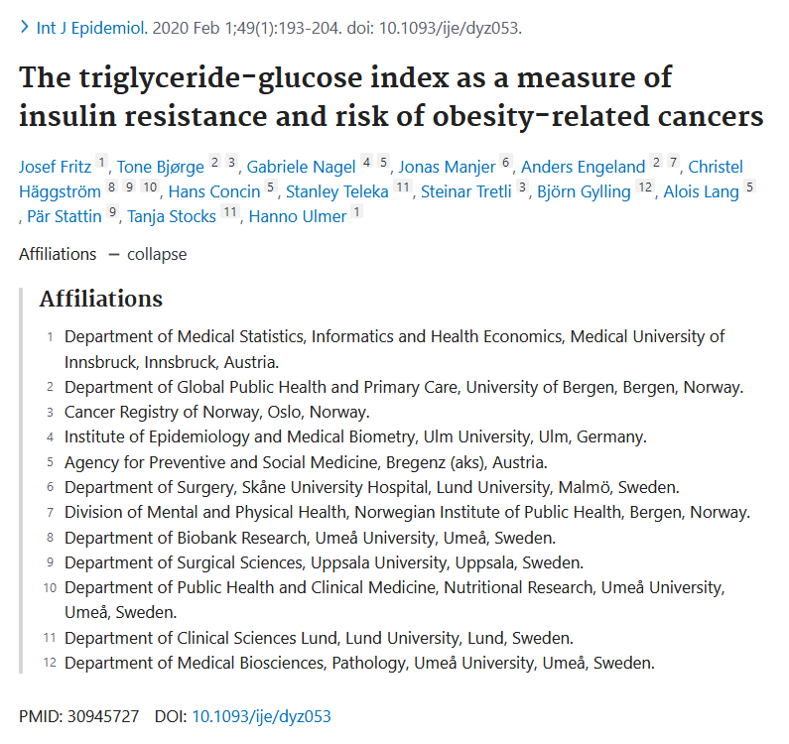
Hanno Ulmer
Tanja Stocks

Slide 22
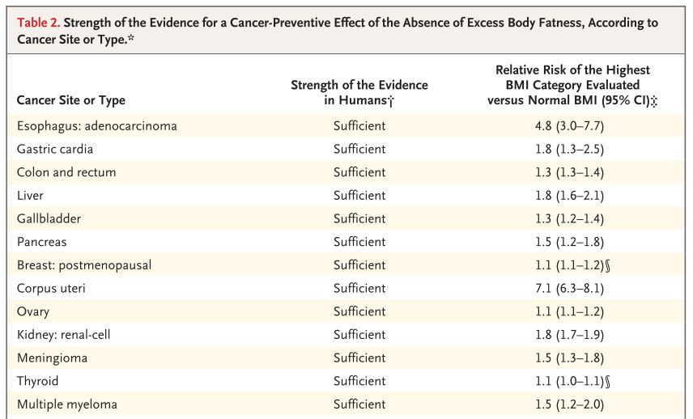
Excess body weight is a major risk factor for many cancer forms
Body Fatness and Cancer — Viewpoint of the IARC Working Group : New Engl J Med, 2016

Slide 23
Excess body weight and cancer risk: proposed biological mechanisms
Renehan AG, Zwahlen M, Egger M. Adiposity and cancer risk: new mechanistic insights from epidemiology. Nat Rev Cancer 2015.

Slide 24
TyG Index: A Novel Measure for Insulin Resistance
TyG index = the logarithmized product of fasting levels of triglycerides and glucose (“TyG index”).
Simple measure of insulin resistance.
Good correlation with the euglycemic-hyperinsulinemic clamp test (Pearson correlation of -0.68), similar magnitude as the frequently used HOMA-IR.
Both lipotoxicity and glucotoxicity play crucial roles in insulin resistance modulation and are reflected in the TyG index.
A promising surrogate measure for insulin resistance in large-scale epidemiological studies.
First proposed by: Simental-Mendía LE et al. The Product of Fasting Glucose and Triglycerides As Surrogate for Identifying Insulin Resistance in Apparently Healthy Subjects. Metab Syndr Relat Disord 2008.

Slide 25
Study design & Methods
Prospective cohort study (cohorts from Austria, Norway, and Sweden)
510,471 participants free of cancer at baseline
Mean age at baseline: 43.1 years
Median follow-up time: 17.2 years
X: BMI as a measure of excess body weight, at baseline
M: TyG index as a measure of insulin resistance, at baseline
Y: incident cancer, various sites
C: baseline age, sex, smoking status, fasting status, cohort, decade of birth
First 12 month of follow-up excluded
Regression-based approach from VanderWeele with exposure-mediator interaction (see slide no. 15)

Slide 26
Baseline characteristics by quintiles of TyG index, Me-Can population
 | TyG index
 | Quintile 1 (N=102,521) | Quintile 2 (N=102,020) | Quintile 3 (N=101,851) | Quintile 4 (N=101,954) | Quintile 5 (N=102,125)
TyG index, mean (SD) | 7.8 (0.2) | 8.3 (0.1) | 8.5 (0.1) | 8.9 (0.1) | 9.5 (0.4)
TyG index, range | <8.1 | 8.1 to 8.4 | 8.4 to 8.7 | 8.7 to 9.1 | >9.1
BMI categories
<18.5 kg/m² | 3.8% | 2.1% | 1.3% | 0.7% | 0.3%
18.5 to 24.9 kg/m² | 72.1% | 61.7% | 53.3% | 42.6% | 28.7%
25 to 29.9 kg/m² | 20.7% | 29.7% | 35.6% | 42.4% | 48.7%
≥30.0 kg/m² | 3.4% | 6.5% | 9.7% | 14.2% | 22.3%
Sex, male | 32.3% | 40.5% | 48.7% | 58.7% | 72.5%
Age, yrs, mean (SD) | 39.6 (11.0) | 42.8 (10.7) | 43.6 (10.7) | 44.4 (10.2) | 44.9 (9.4)

Slide 27
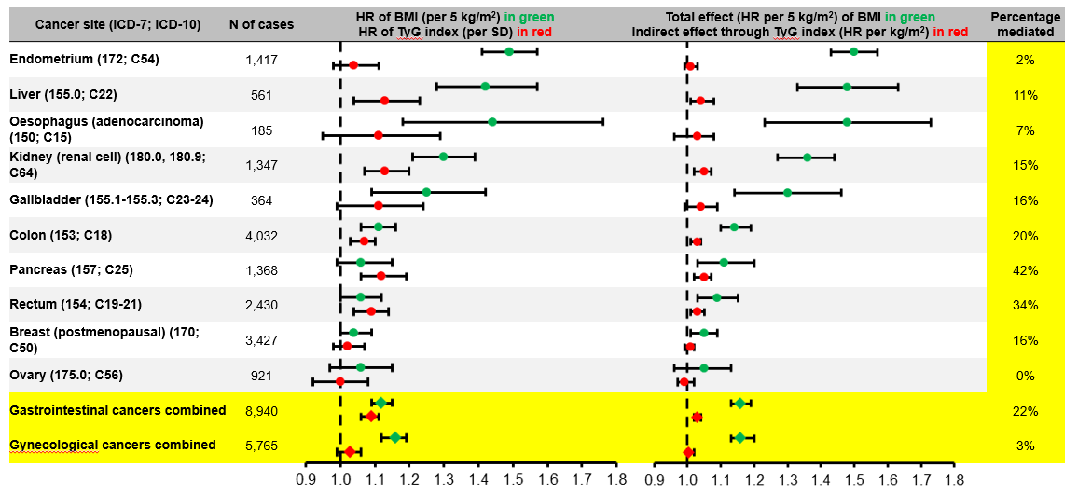
HRs of BMI and TyG index on cancer risk from a standard multivariable Cox model (conditioned on BMI, TyG index, baseline age, sex, smoking status, fasting status, cohort, and decade of birth)
Total (in green) and indirect (through TyG index; in red) effects of BMI on cancer risk from the causal model with confounders baseline age, sex, smoking status, fasting status, cohort, and decade of birth. Bootstrap 95% CIs.

Slide 28
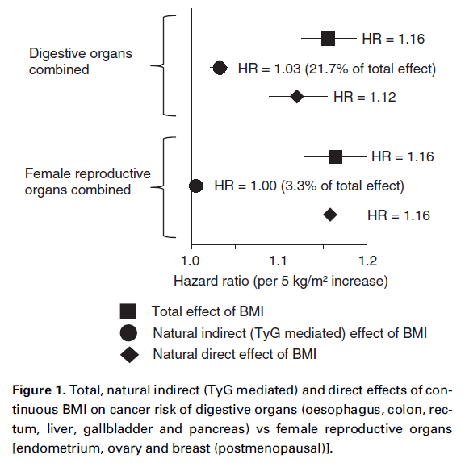
The TyG Index substantially mediated the effect of BMI for gastrointestinal cancers, but not for gynecological cancers.
Our results confirm a promoting role of insulin resistance as measured through the TyG index in the pathogenesis of gastrointestinal cancers.
Our results provide limited evidence that insulin resistance as measured through the TyG index connects excess body weight with risk of cancers of the female reproductive organs.

Slide 29
Summary
Causal statistical mediation analysis in the counterfactual framework
Methods of estimates
Application on an oncological research question
Role of insulin resistance in the BMI – cancer risk relationship
Current/Ongoing work:
Obesity and prostate cancer-specific death: is insulin resistance (measured as the TyG index) a mediator in this relationship?
Effect decomposition in the case of multiple mediators potentially causally affecting each other
Single and joint contributions of the pathways through
(i) insulin resistance, (ii) hypertension, (iii) hyperuricemia and (iv) hypercholesterolemia
to the total effect of obesity on end-stage kidney disease

Slide 30
Any questions?

Slide 31
Back-up slides

Slide 32
Remarks - regression-based approaches Tyler Vanderweele
Derivation of NIE and NDE for various outcome and mediator models
Outcome: additive hazards model, accelerated failure time model
Mediator: continuous, binary
New formulas each time
In case of linear models and no exposure-mediator interaction, NIE und NDE simplify to the path-specific effects from structural equation models (SEMs)
Extensions for several mediators ‘en bloc’
R package regmedint (version 0.2.1)

Slide 33
Remarks - Natural effect models (NEMs) Theis Lange (2012)
Flexible, since the two regression models involved (step 1 and 4) can be of any type
Mediator can also be a vector of variables
Extensions for continuous exposures
Weighting-based alternative
Generalization to multiple mediators (not causally affecting each other)
R package medflex (version 0.6-7)

Slide 34
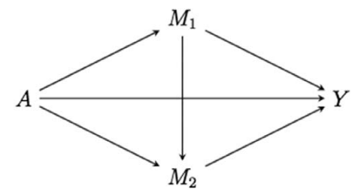
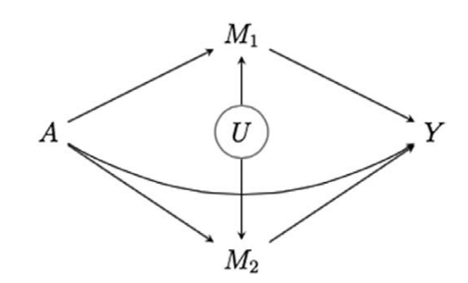
Extensions: Multiple mediators
Beyond natural indirect effects – decomposition of total effect into direct effect, indirect effect through M_{1,} and indirect effect through M₂
→ Sequential mediation analysis
VanderWeele TJ, Vansteelandt S. Mediation Analysis with Multiple Mediators. Epidemiol Method, 2014.
→ Interventional direct and indirect effects
Vansteelandt S, Daniel RM. Interventional Effects for Mediation Analysis with Multiple Mediators. Epidemiology, 2017.

Slide 35
Extensions: Time-varying exposures and mediators

Slide 36
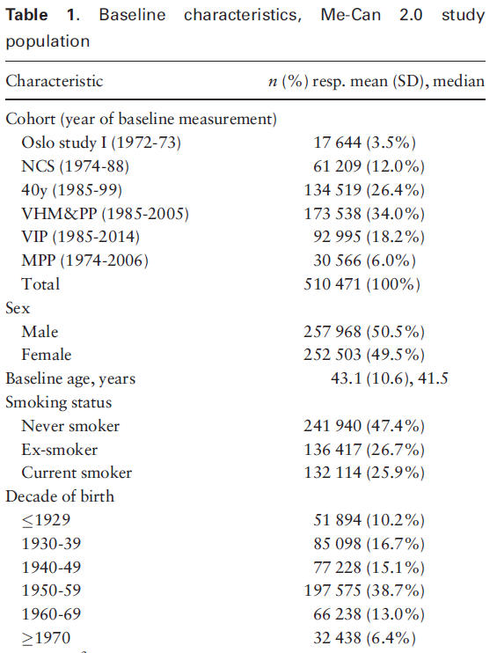
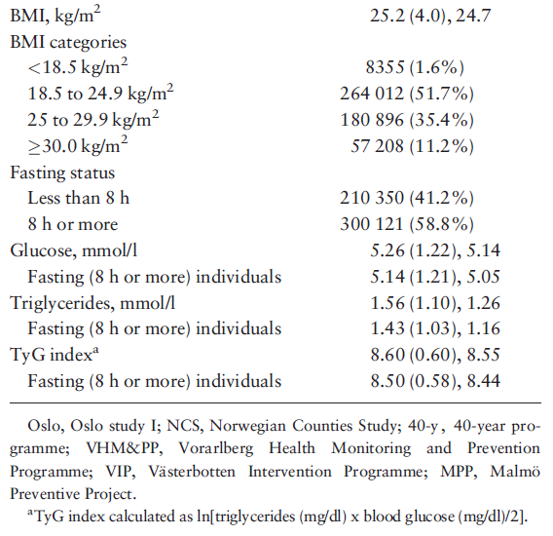

Slide 37
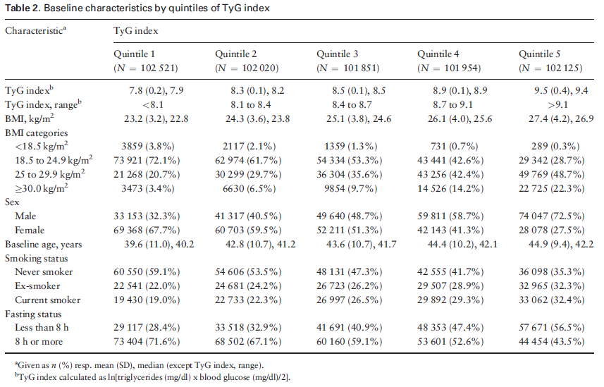

Slide 38
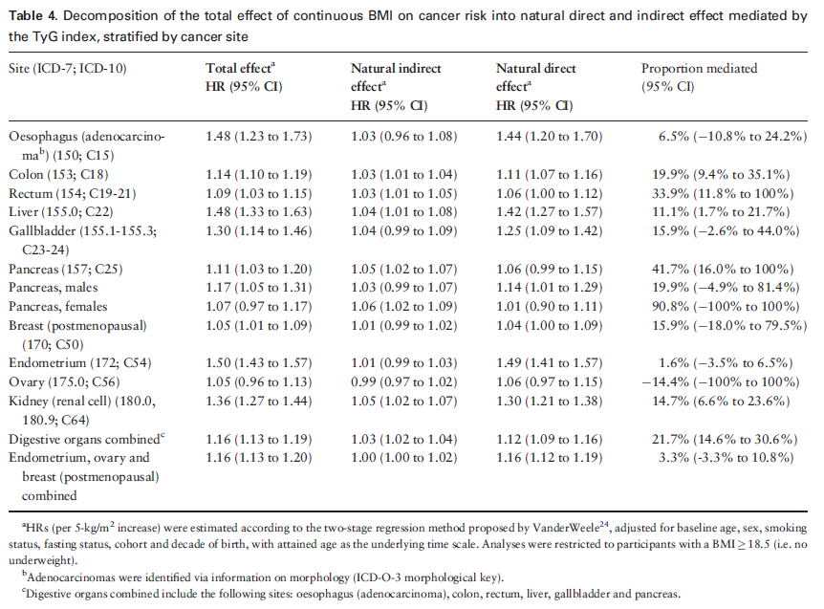

Slide 39
